Slide 1


Risk Management Toolkit
Overview

Slide 2
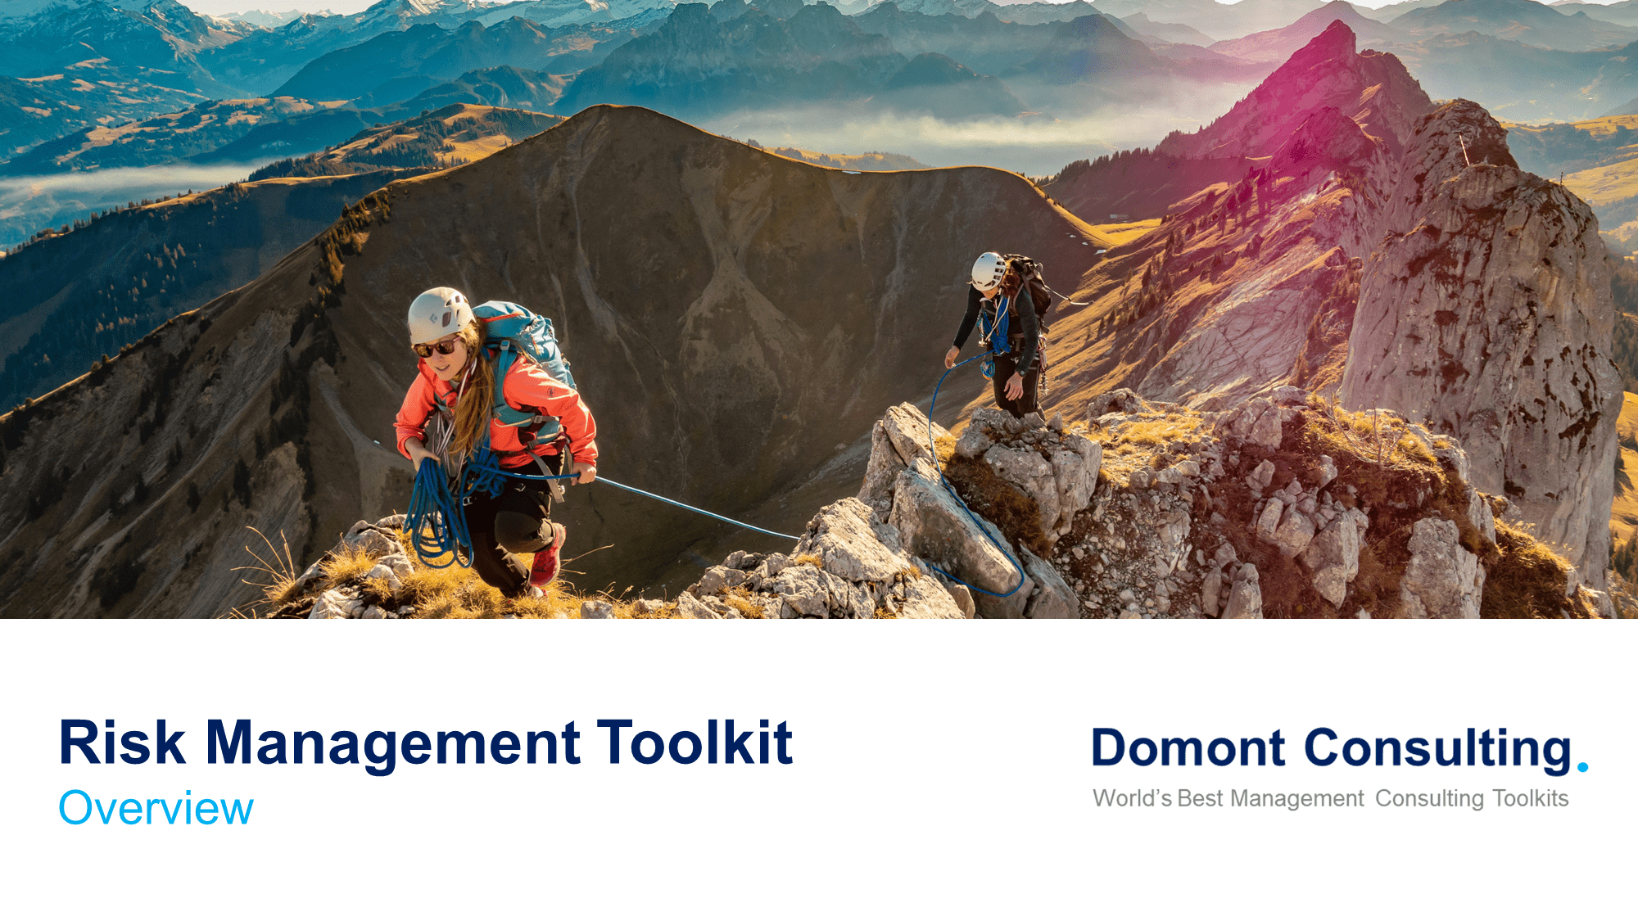
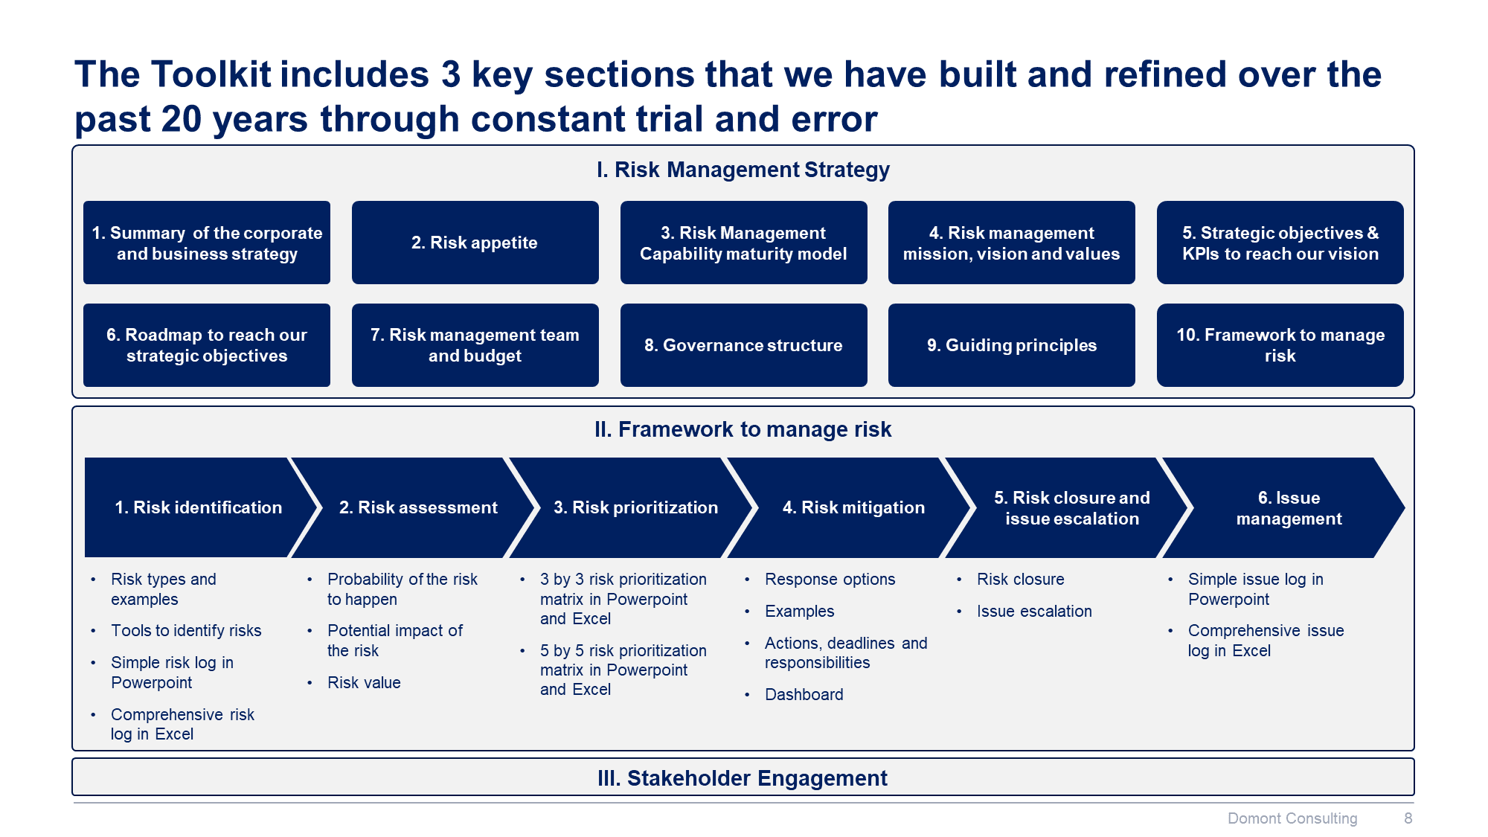
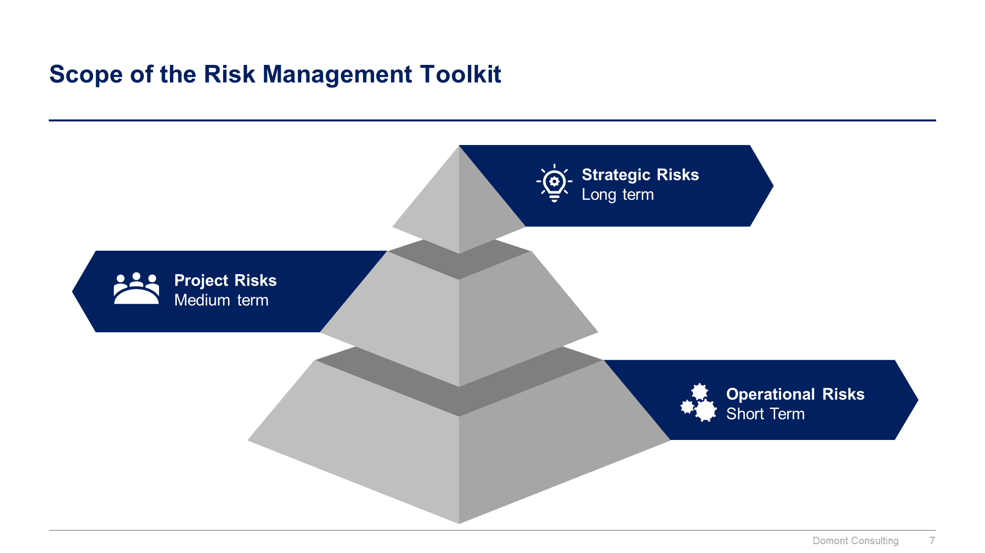
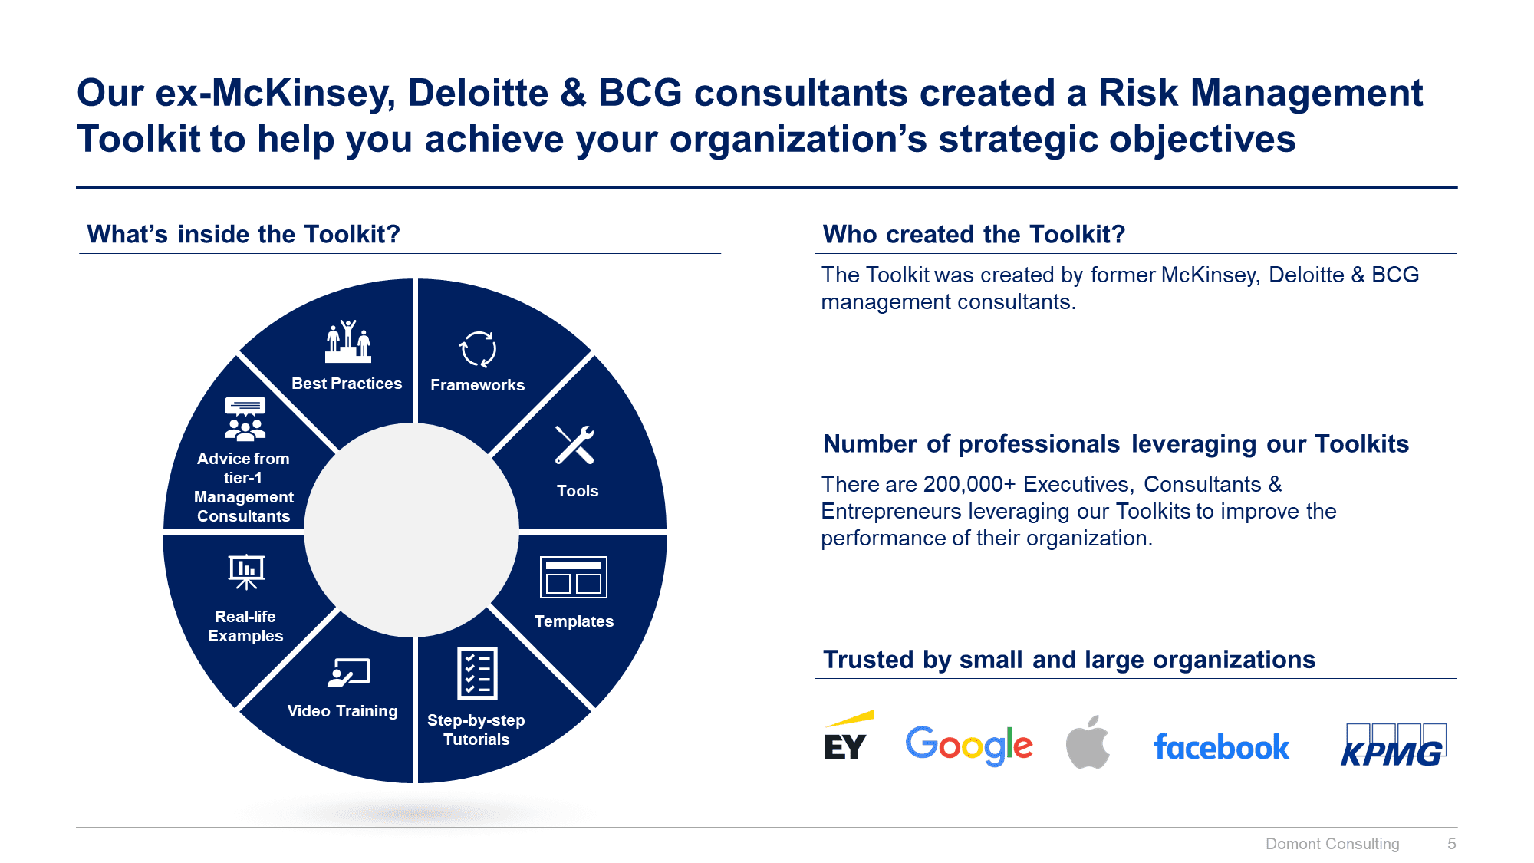
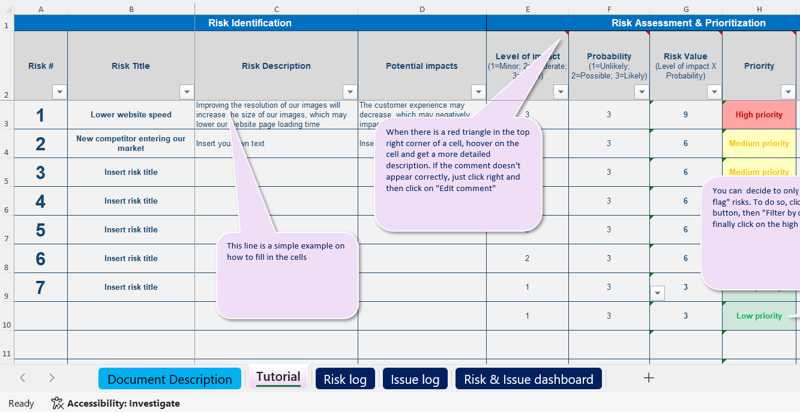
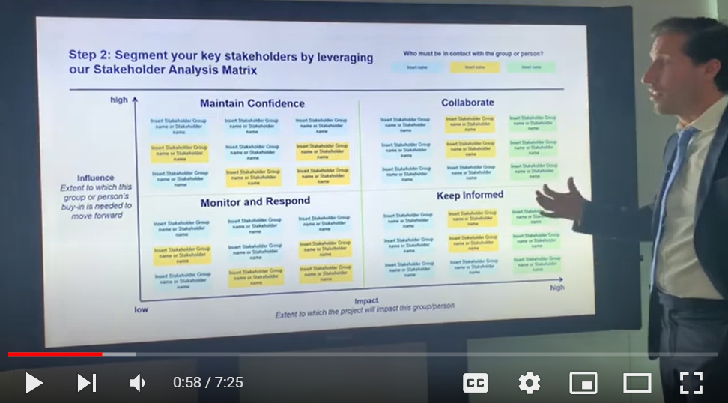
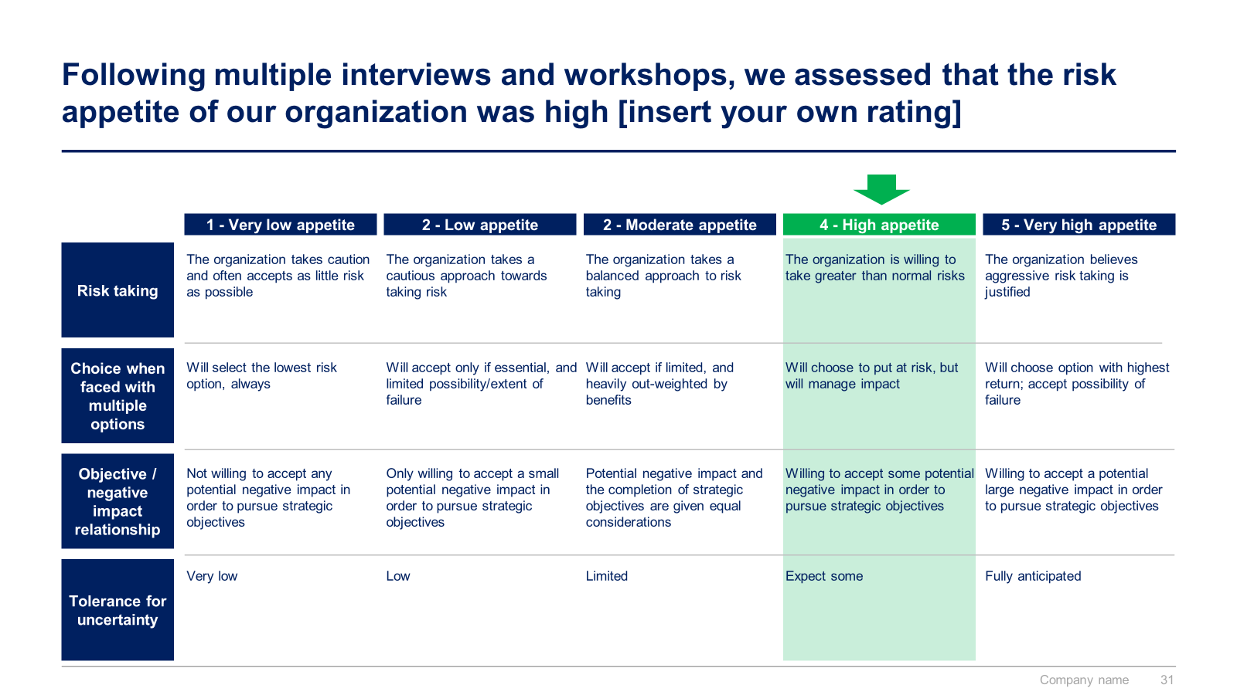
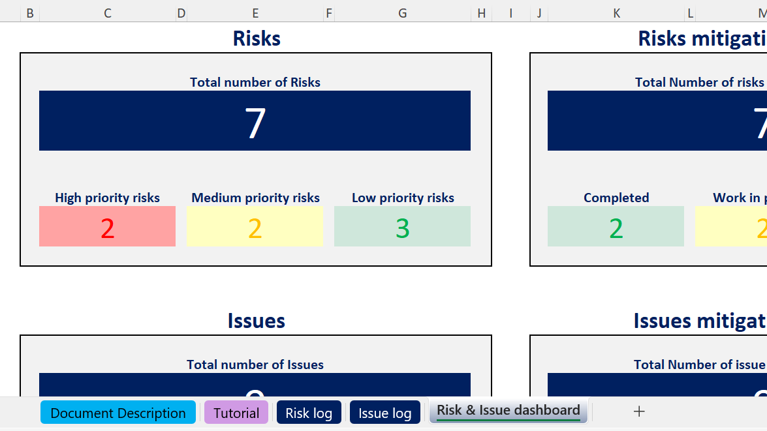
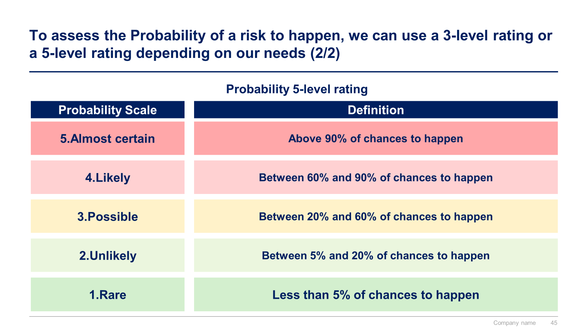

Slide 3


Introduction
This Toolkit was created by ex-McKinsey, Deloitte and BCG Management Consultants. It will help you define your risk management strategy, and easily identify, assess, prioritize and mitigate the key risks & issues of your project or company. It includes all the Frameworks, Tools & Templates to help your increase your risk management skills and the risk management capability of your company.
Join the 200,000+ Executives, Consultants & Entrepreneurs who are already leveraging our Management Consulting Toolkits to improve the performance of their organization and boost their own career.
If you have any questions, send us an email at support@domontconsulting.com and one of our ex-McKinsey, Deloitte & BCG Management Consultants will get back to you within 2 business days.
Aurelien Domont
Management Consultant
Domont Consulting Managing Director

Slide 4
Context and key definitions
Context
Key definitions
Risk management is an important function in organizations today.
Companies undertake increasingly complex and ambitious initiatives, and those initiatives must be executed successfully, in an uncertain and often risky environment.
Risk management is the culture, processes, and structures that are directed towards realizing potential opportunities, whilst managing adverse effects.
A risk is a measure of the potential inability to achieve a goal or target within defined safety, cost, schedule, and technical constraints. A risk has two components: the likelihood of failing to achieve a particular outcome, and the consequence of failing to achieve it. A risk is a future event and can often be managed proactively.
An issue is a risk that has occurred and has become a problem. It is an undesirable event that has occurred and its occurrence cannot be stopped or directly controlled.
Risk assessment is the qualitative and/or quantitative evaluation of the likelihood and consequence of a risk occurring.
Likelihood is the probability of a specified outcome.
A closed risk is one that no longer exists (i.e., the risk has evolved into an issue or is no longer relevant), is no longer cost-effective to track, or has been mitigated.
A risk owner is an individual to whom a risk is assigned. The risk owner is responsible and accountable for identifying, implementing, and tracking the risk mitigation strategy and actions.

Slide 5
Benefits of risk management
1
Increase the likelihood of achieving the organization’s strategic and business objectives
2
Encourage a high standard of accountability at all levels of the organization
3
Support more effective decision making through better understanding of risk exposure
4
Create an environment that enables the organization to deliver timely services and meet performance objectives in an efficient and cost-effective manner
5
Safeguard the key assets of the organization: human, property, and reputation
6
Meet compliance and governance requirements

Slide 6












Our ex-McKinsey, Deloitte & BCG consultants created a Risk Management Toolkit to help you achieve your organization’s strategic objectives
What’s inside the Toolkit?
Who created the Toolkit?
The Toolkit was created by former McKinsey, Deloitte & BCG management consultants.
Best Practices
Frameworks
Number of professionals leveraging our Toolkits
Advice from
tier-1 Management Consultants
Tools
There are 200,000+ Executives, Consultants & Entrepreneurs leveraging our Toolkits to improve the performance of their organization.
Real-life Examples
Templates
Trusted by small and large organizations
Video Training
Step-by-step Tutorials

Slide 7
Our Toolkit will help you fulfill multiple objectives
The Risk Management Toolkit includes frameworks, tools, templates, tutorials, real-life examples, video training, and best practices to help you:
Define and implement your risk management strategy: (1) Summary of the corporate and business strategy, (2) Risk appetite, (3) Risk management capability maturity model, (4) Risk management mission, vision and values, (5) Strategic objectives & KPIs to reach our vision, (6) Roadmap to reach our strategic objectives, (7) Risk management team and budget, (8) Governance structure, (9) Guiding principles, (10) Framework to manage risk
Build a robust 6-step framework to manage risk: (1) Risk identification, (2) Risk assessment, (3) Risk prioritization, (4) Risk mitigation, (5) Risk closure and issue escalation, (6) Issue management
Easily identify, assess, and mitigate the key risks and issues of your project or company by leveraging our risk management framework, risk log, issue log, risk assessment matrix, and risk and issue dashboard
Prioritize your risks based on the potential impact of the risk and the probability of the risk to happen
Automatically calculate your number of high, medium, and low priority risks and issues with our risk and issue dashboard
Present a robust risk management approach and risk assessment overview to your board of directors, executive committee, or program manager
Get a high-level view of all your risks with our 3-by-3 risk prioritization matrix and 5-by-5 risk prioritization matrix
Engage your stakeholders effectively: (1) Stakeholder analysis, (2) Stakeholder engagement strategy, (3) Stakeholder engagement detailed plan

Slide 8

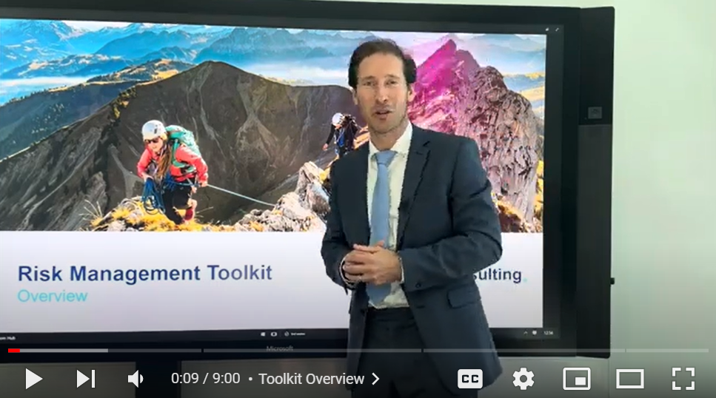
Video demonstration of the Toolkit
Video Demo Access
Video Demo Visual
Select “Slide Show” mode and then click on the link below or on the image on the right to access this video demo.
You can also access the video by copy pasting the following URL in your browser:
https://youtu.be/sDdY6_KaR9k

Slide 9


Scope of the Risk Management Toolkit
Strategic Risks
Long term
Project Risks
Medium term
Operational Risks
Short Term

Slide 10
The Toolkit includes 3 key sections that we have built and refined over the past 20 years through constant trial and error
I. Risk Management Strategy
1. Summary of the corporate and business strategy
2. Risk appetite
3. Risk Management Capability maturity model
4. Risk management mission, vision and values
5. Strategic objectives & KPIs to reach our vision
6. Roadmap to reach our strategic objectives
7. Risk management team and budget
8. Governance structure
9. Guiding principles
10. Framework to manage risk
II. Framework to manage risk
1. Risk identification
2. Risk assessment
3. Risk prioritization
4. Risk mitigation
5. Risk closure and issue escalation
6. Issue management
Risk types and examples
Tools to identify risks
Simple risk log in Powerpoint
Comprehensive risk log in Excel
Probability of the risk to happen
Potential impact of the risk
Risk value
3 by 3 risk prioritization matrix in Powerpoint and Excel
5 by 5 risk prioritization matrix in Powerpoint and Excel
Response options
Examples
Actions, deadlines and responsibilities
Dashboard
Risk closure
Issue escalation
Simple issue log in Powerpoint
Comprehensive issue log in Excel
III. Stakeholder Engagement

Slide 11
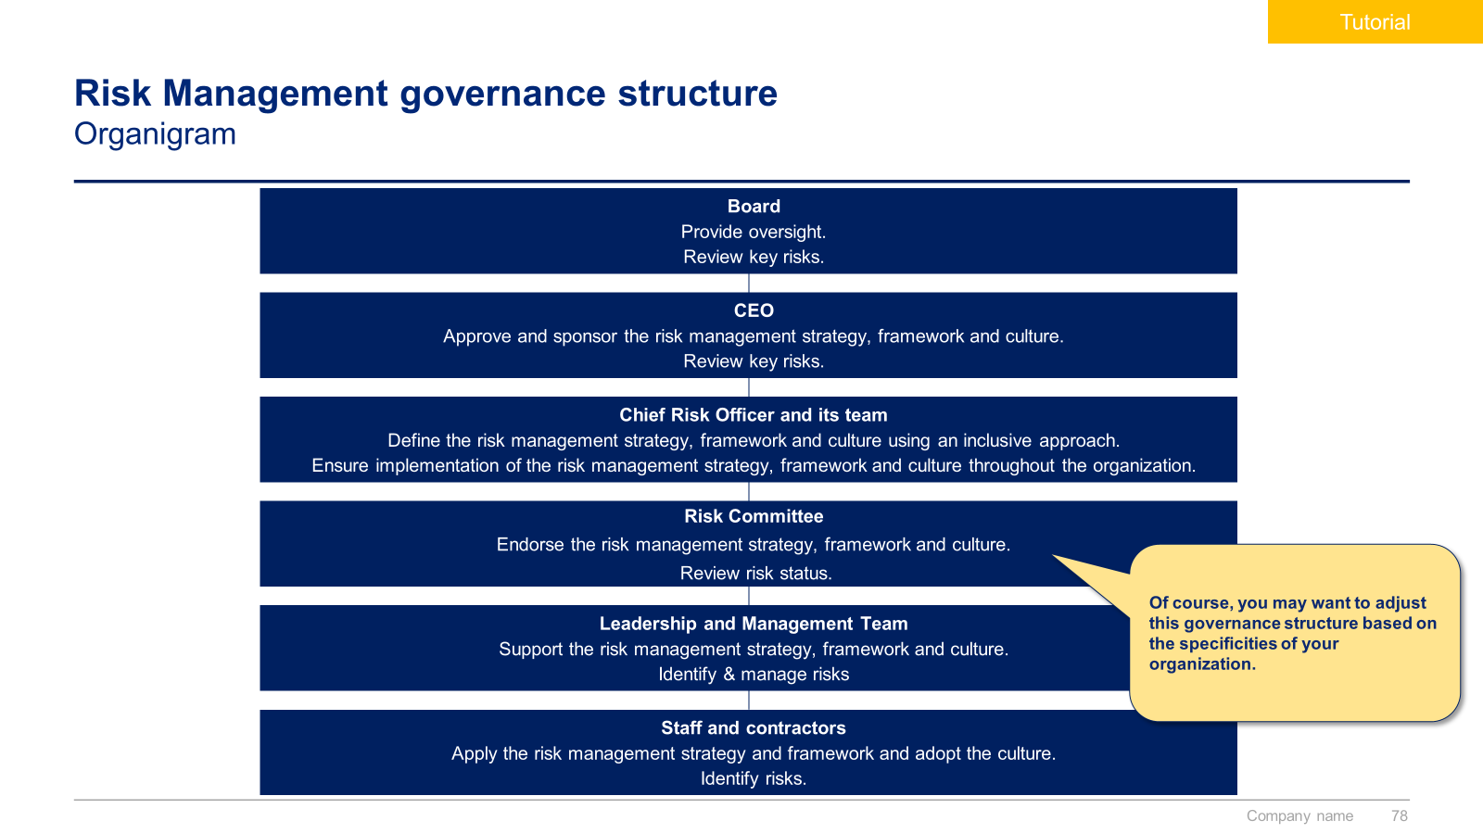
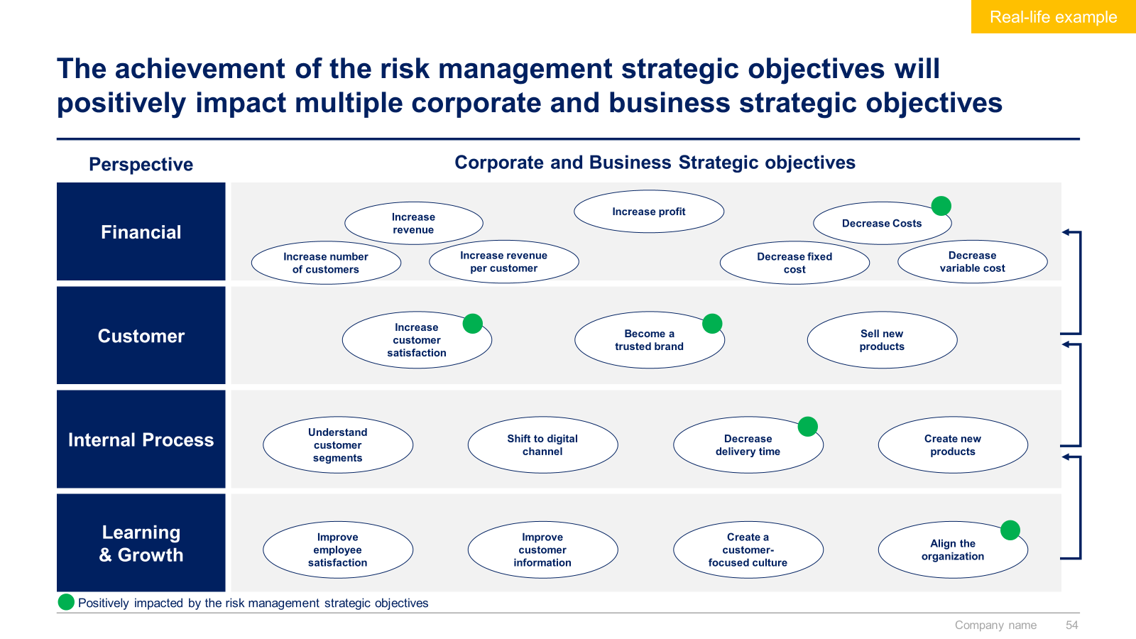
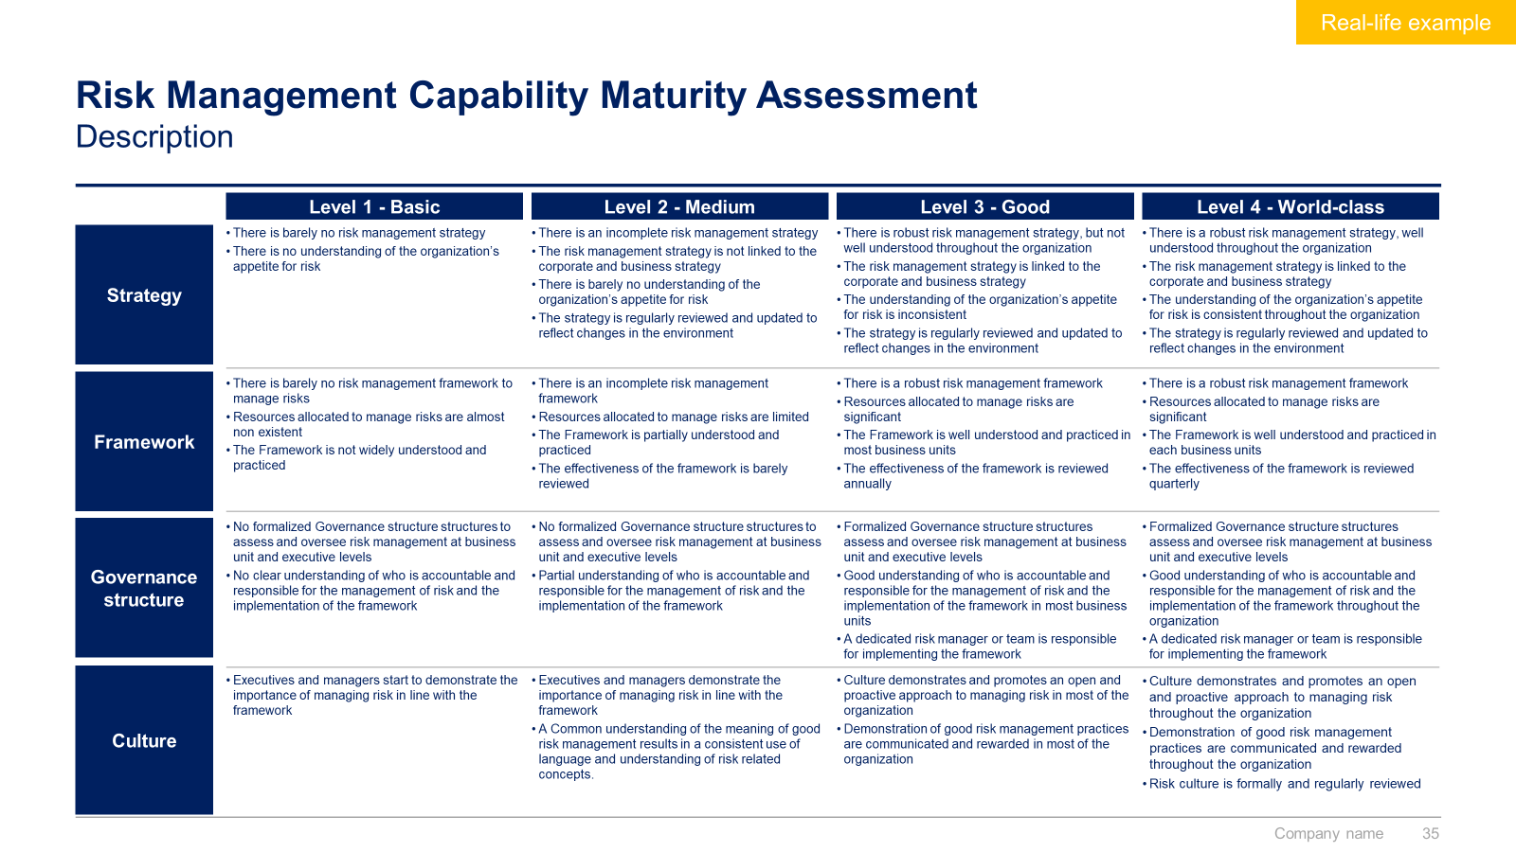
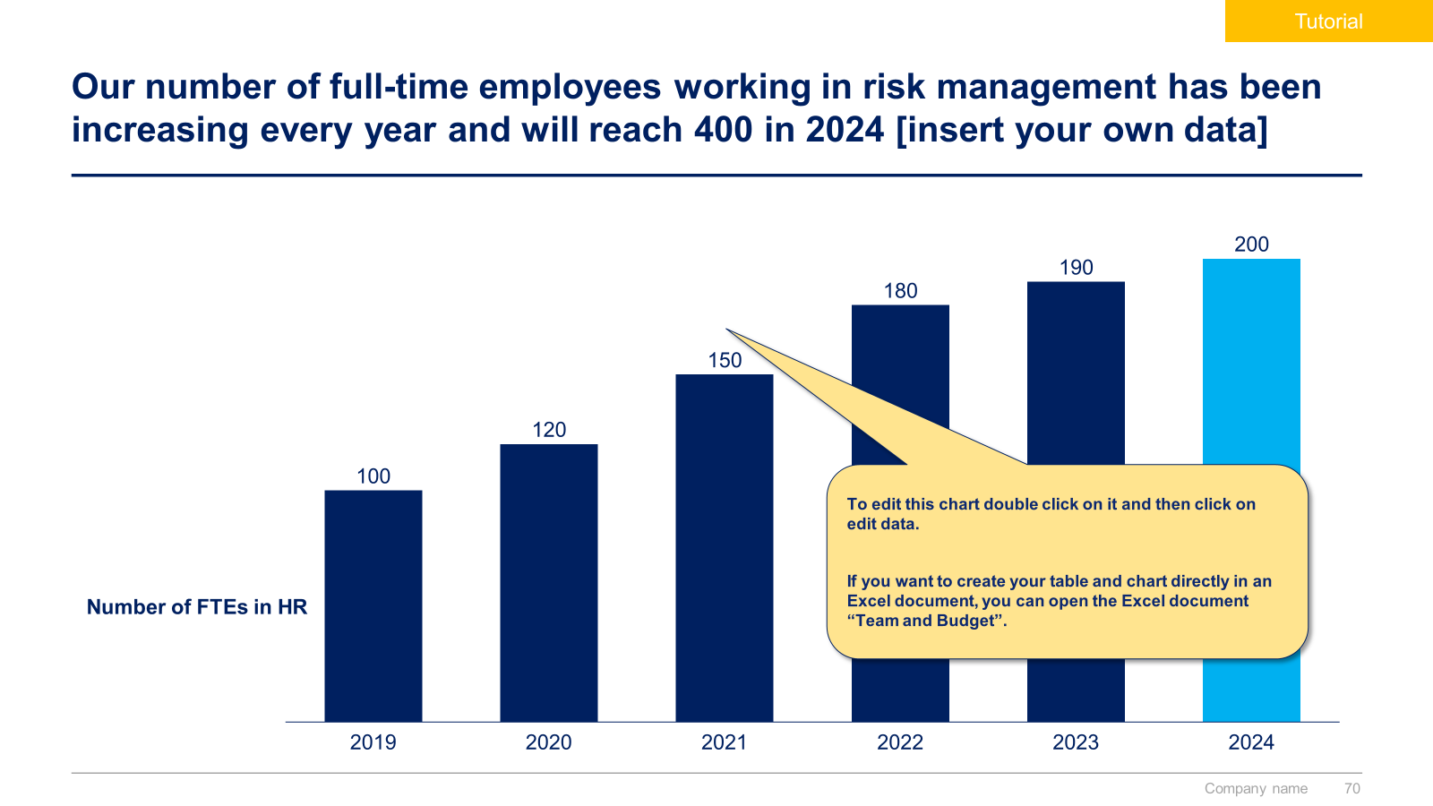
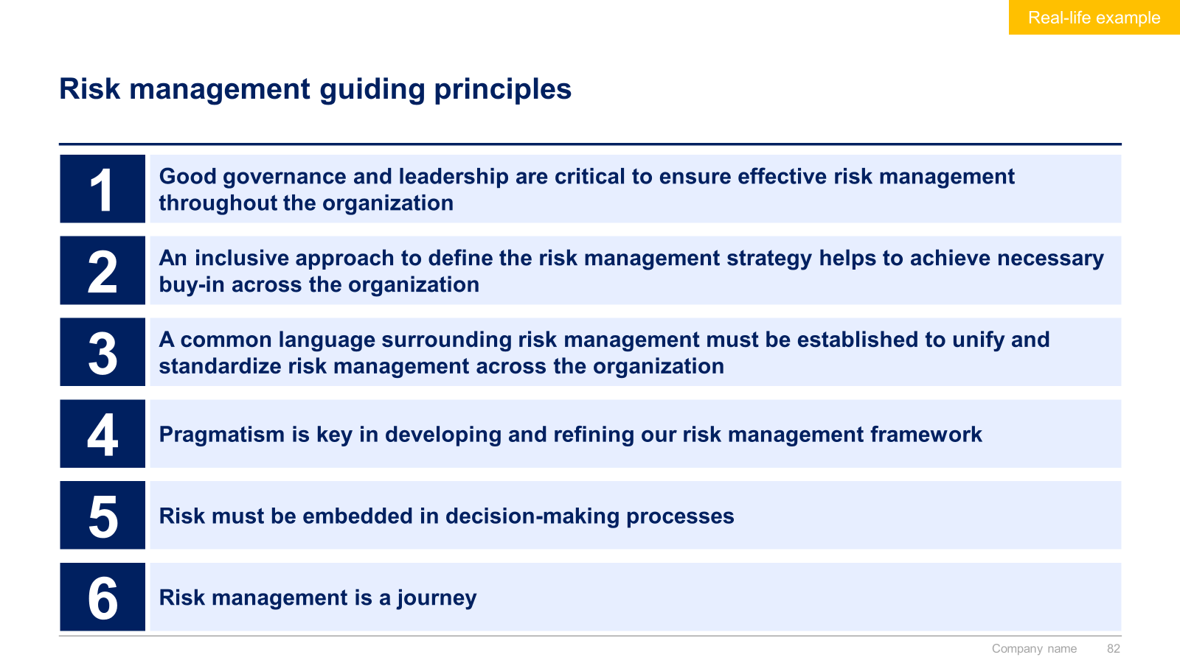
Small preview of the first section ‘Risk Management Strategy’

Slide 12
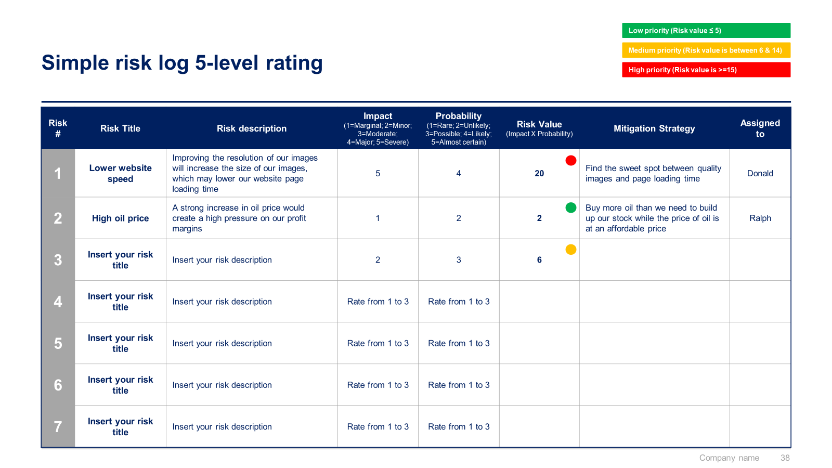
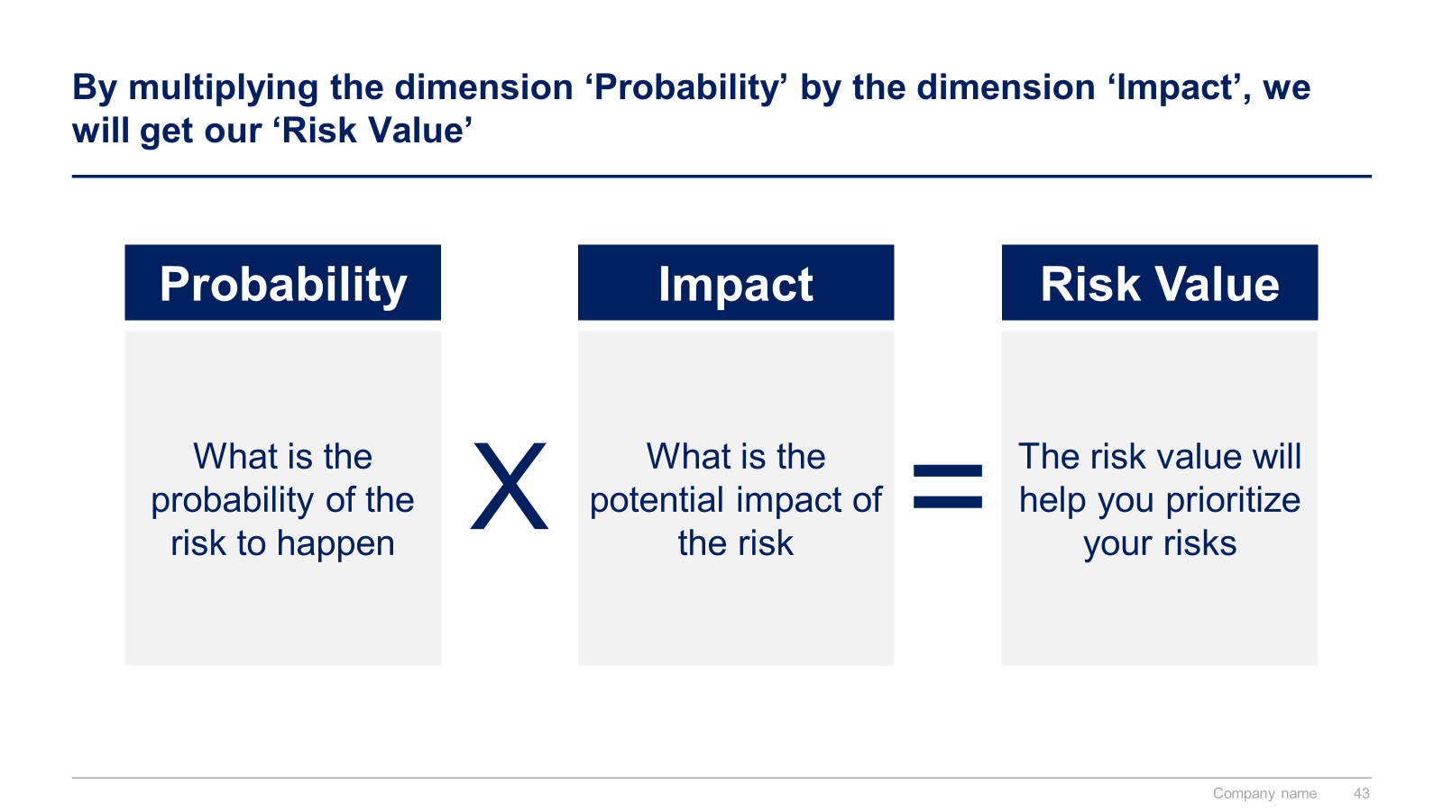
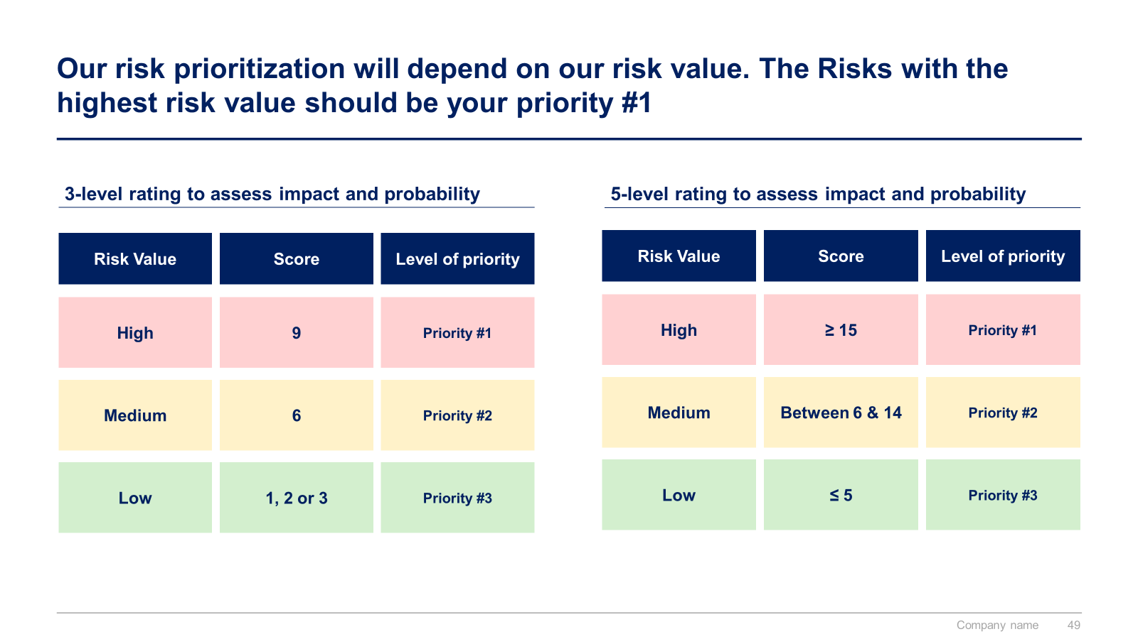
Small preview of the second section ‘Framework to manage risk’

Slide 13
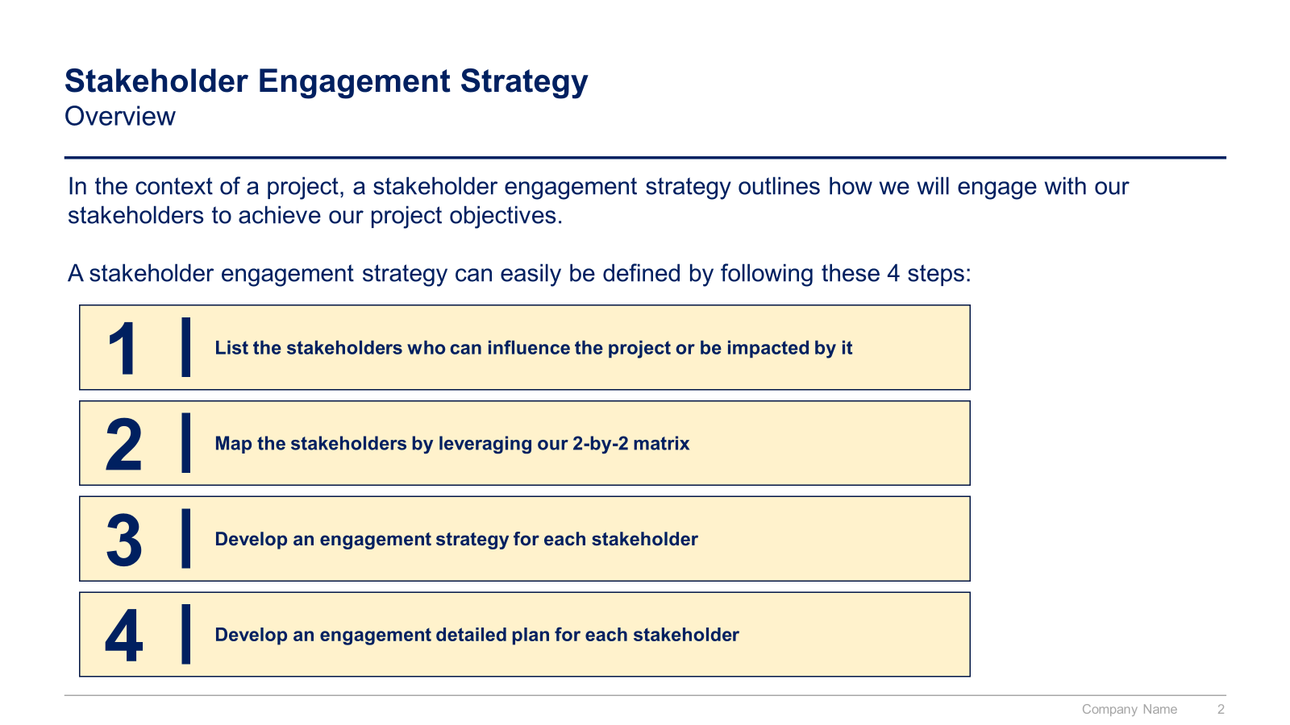
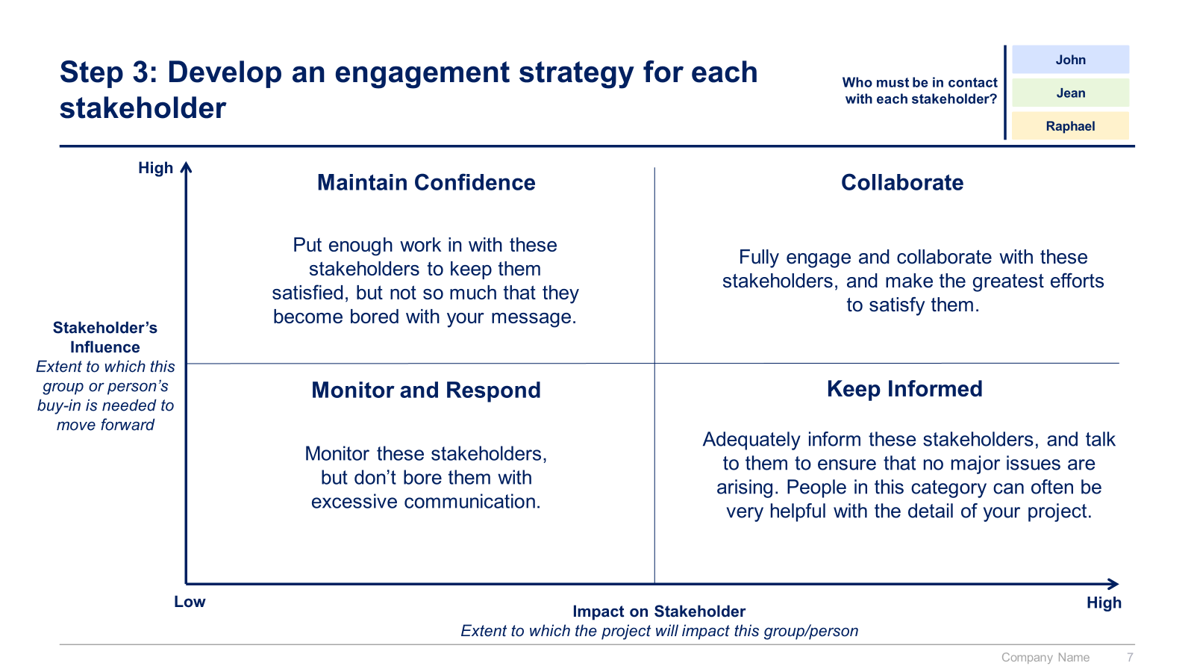
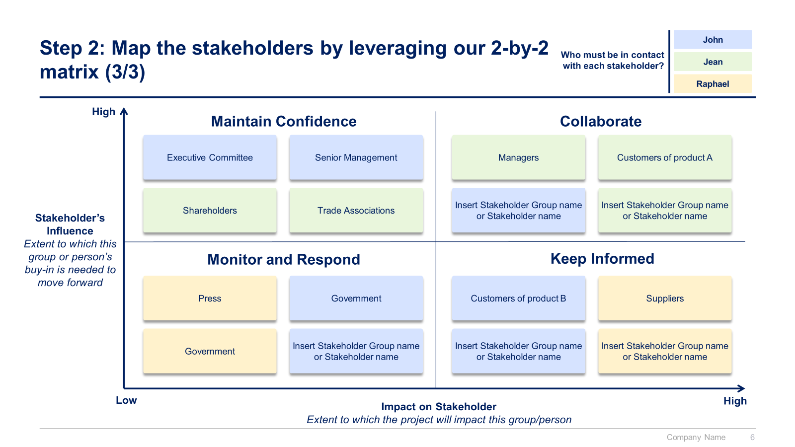
Small preview of the third section ‘Stakeholder Engagement’

Slide 14
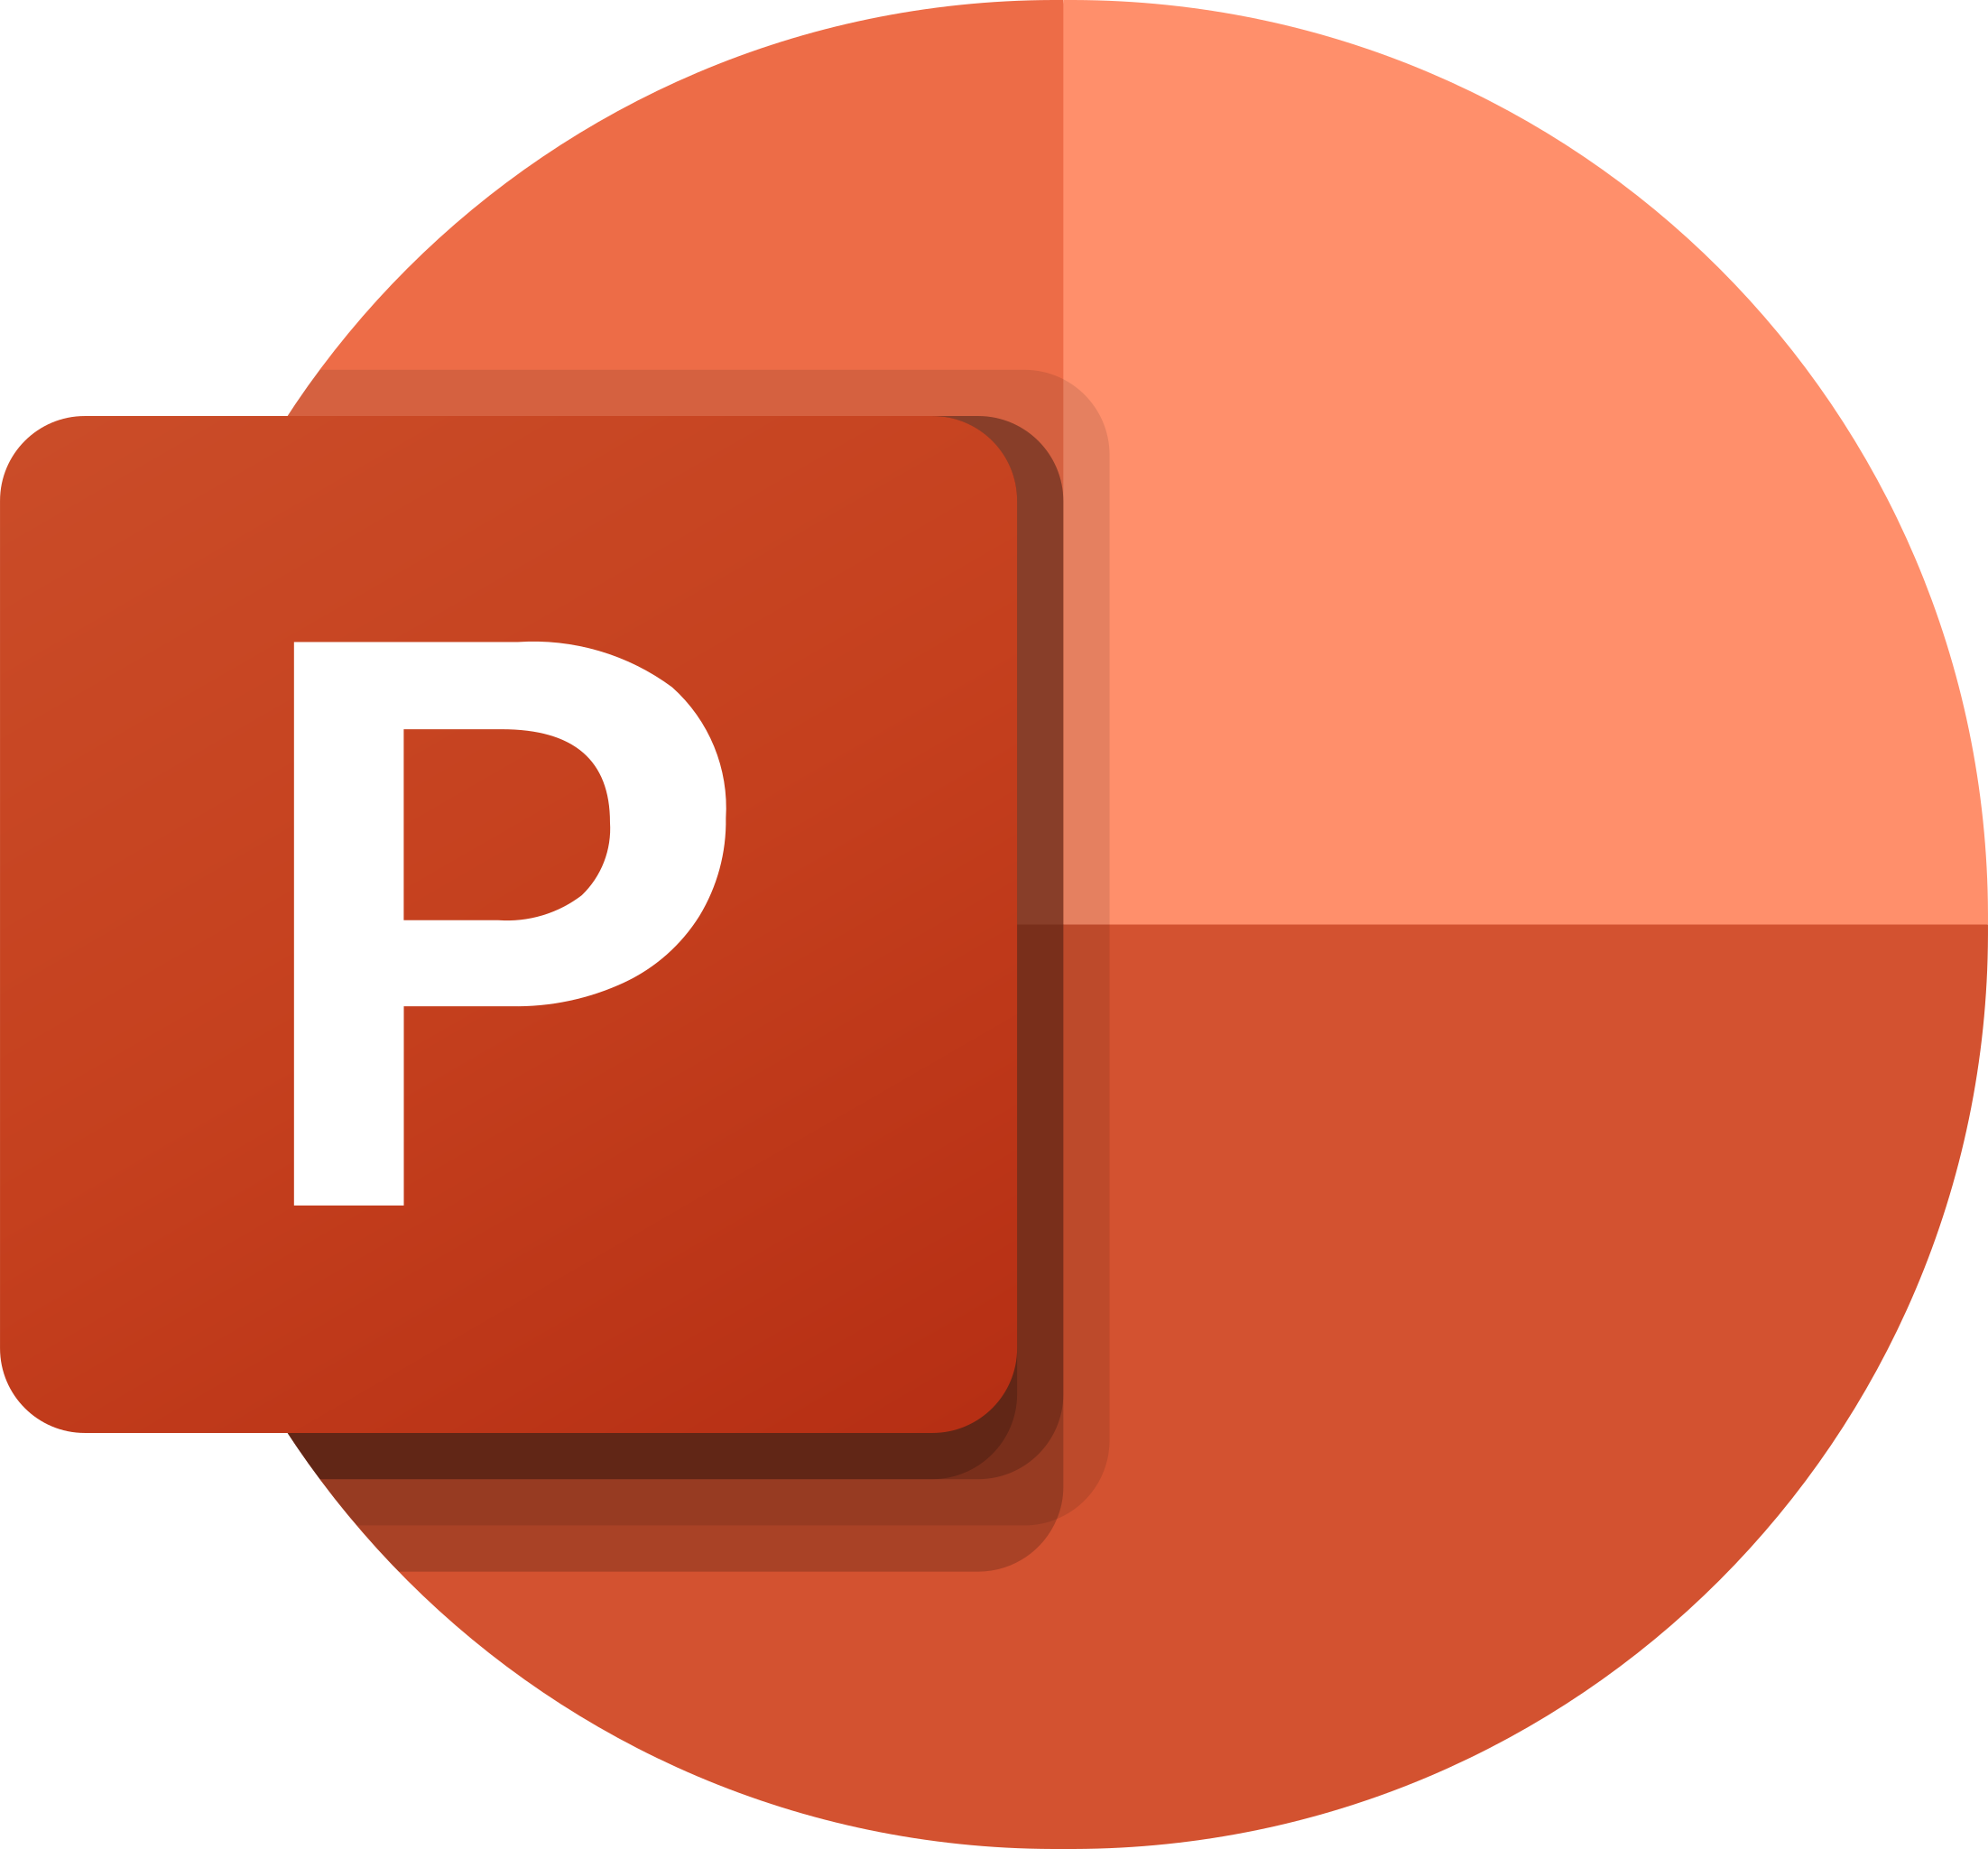
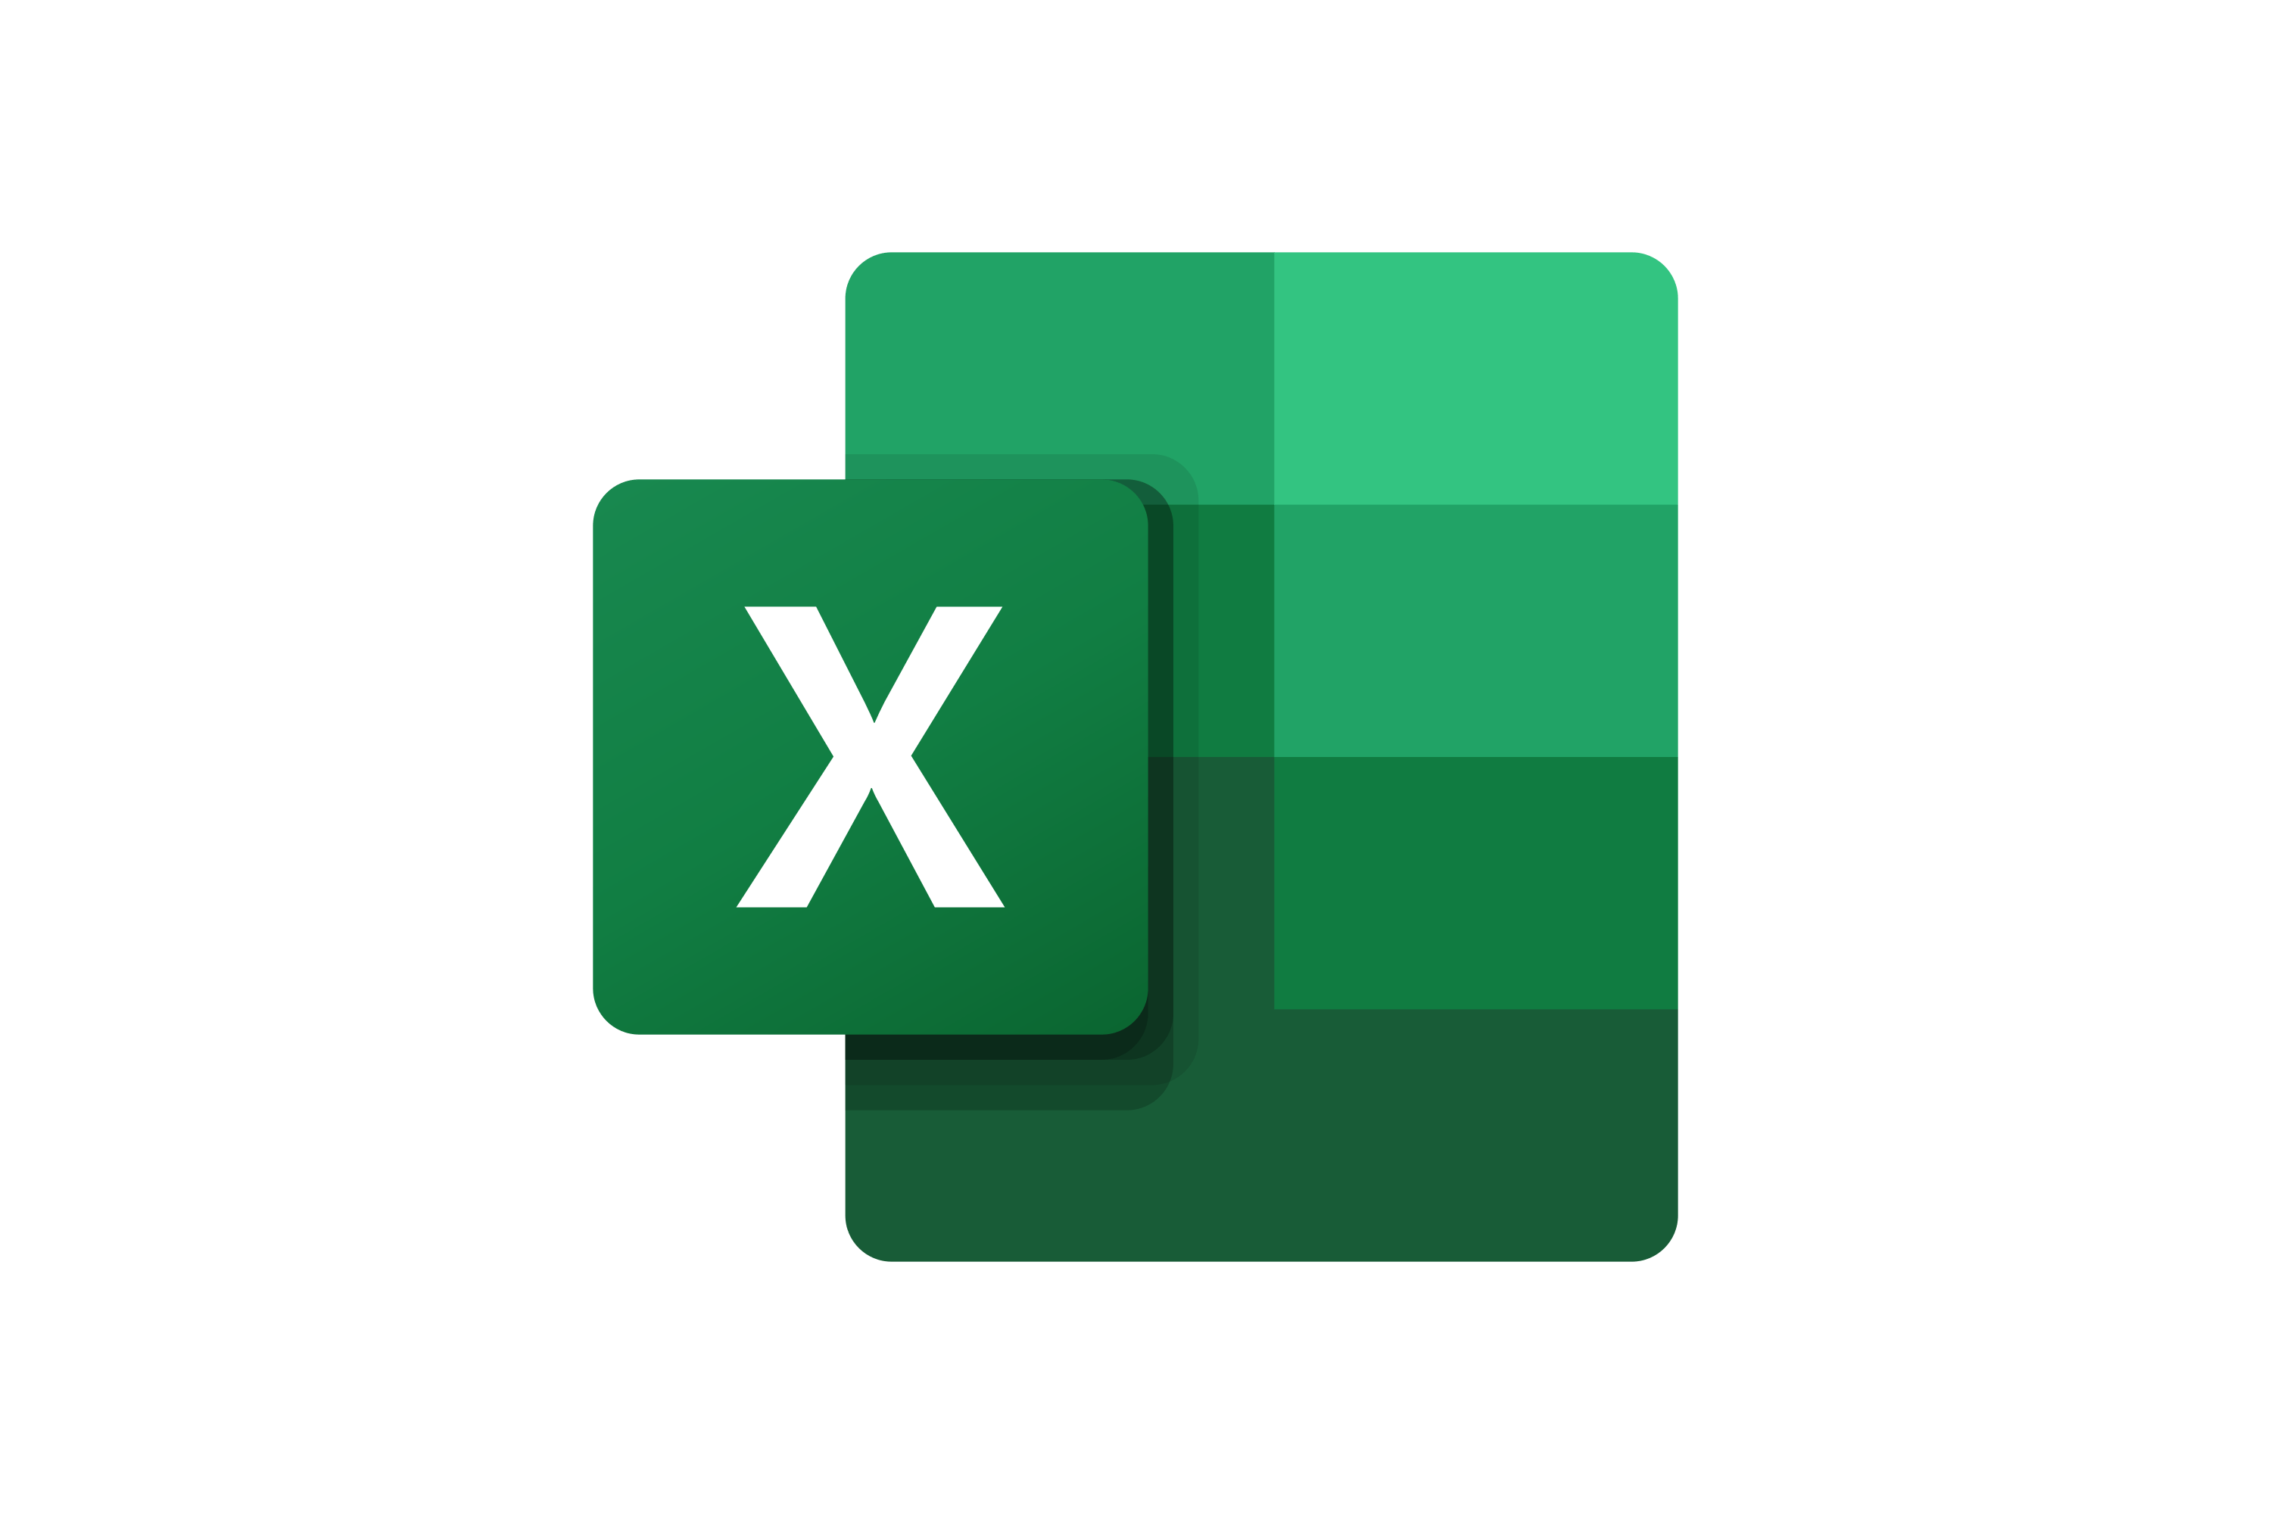

The Toolkit includes multiple PowerPoint slides, Excel sheets and Video training that you can download on your device immediately after purchase
130 editable PowerPoint slides*
13 Excel sheets*
20 minutes of Video training
Overview and Approach
Risk Management Strategy
Framework to Manage Risk
Stakeholder Engagement
*Please note that the number of Powerpoint slides and Excel sheets listed is the number of unique slides and sheets. For example, a Powerpoint slide that has been duplicated to facilitate our clients’ understanding only counts for one slide

Slide 15









Our Management Consulting Toolkits include 9 key benefits
Improve the growth & efficiency of your organization by leveraging Management Consulting Toolkits created by ex-McKinsey, Deloitte & BCG Consultants.
Make a great investment for your career & organization. It cost us US$8M+ over the past 10 years to create all our Toolkits. Get them for a fraction of this cost.
Get a competitive advantage. It’s like hiring Management Consultants to create all the practical Frameworks, Tools & Templates you need.
Get the job done quicker and never start from scratch again with our ready-made and fully editable Frameworks, Tools & Templates in Powerpoint & Excel.
Don't reinvent the wheel. We have already worked 30,000+ hours over the past 10 years to create all the Management Consulting Toolkits you need.
Improve the capabilities of your organization by learning how the Fortune 100 and Global Consulting Firms do it.
Decrease your costs. Hiring tier-1 Consultants for a project would cost you $300k+. Way more expensive than our Toolkits, which will last you a lifetime!
Become your organization’s subject matter expert and impress your stakeholders with world-class approaches to resolve common business problems.
Get free support and advice from our ex-McKinsey, Deloitte & BCG Management Consultants.

Slide 16
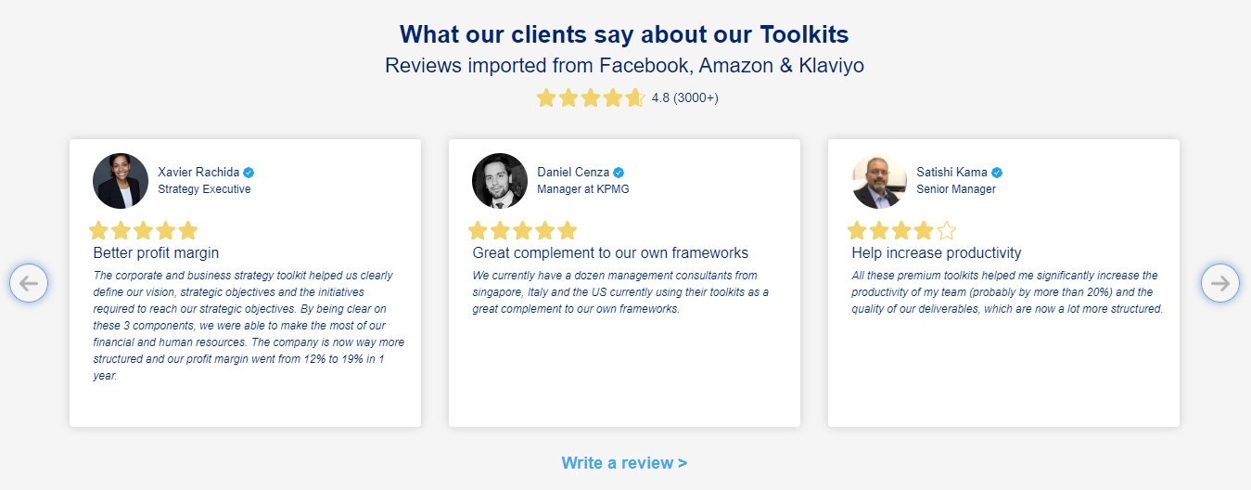
What our clients say about our Toolkits
Click here to see more reviews >

Slide 17

Join 200,000+ Executives, Consultants & Entrepreneurs leveraging our Toolkits to improve the performance of their organization
Trusted by small and large organizations
Customer satisfaction
4.8
Number of countries leveraging our Toolkits
160+
Number of professionals leveraging our Toolkits
200,000+
Daily rate of our ex-McKinsey, Deloitte and BCG Management Consultants
$3k-$4k

Slide 18
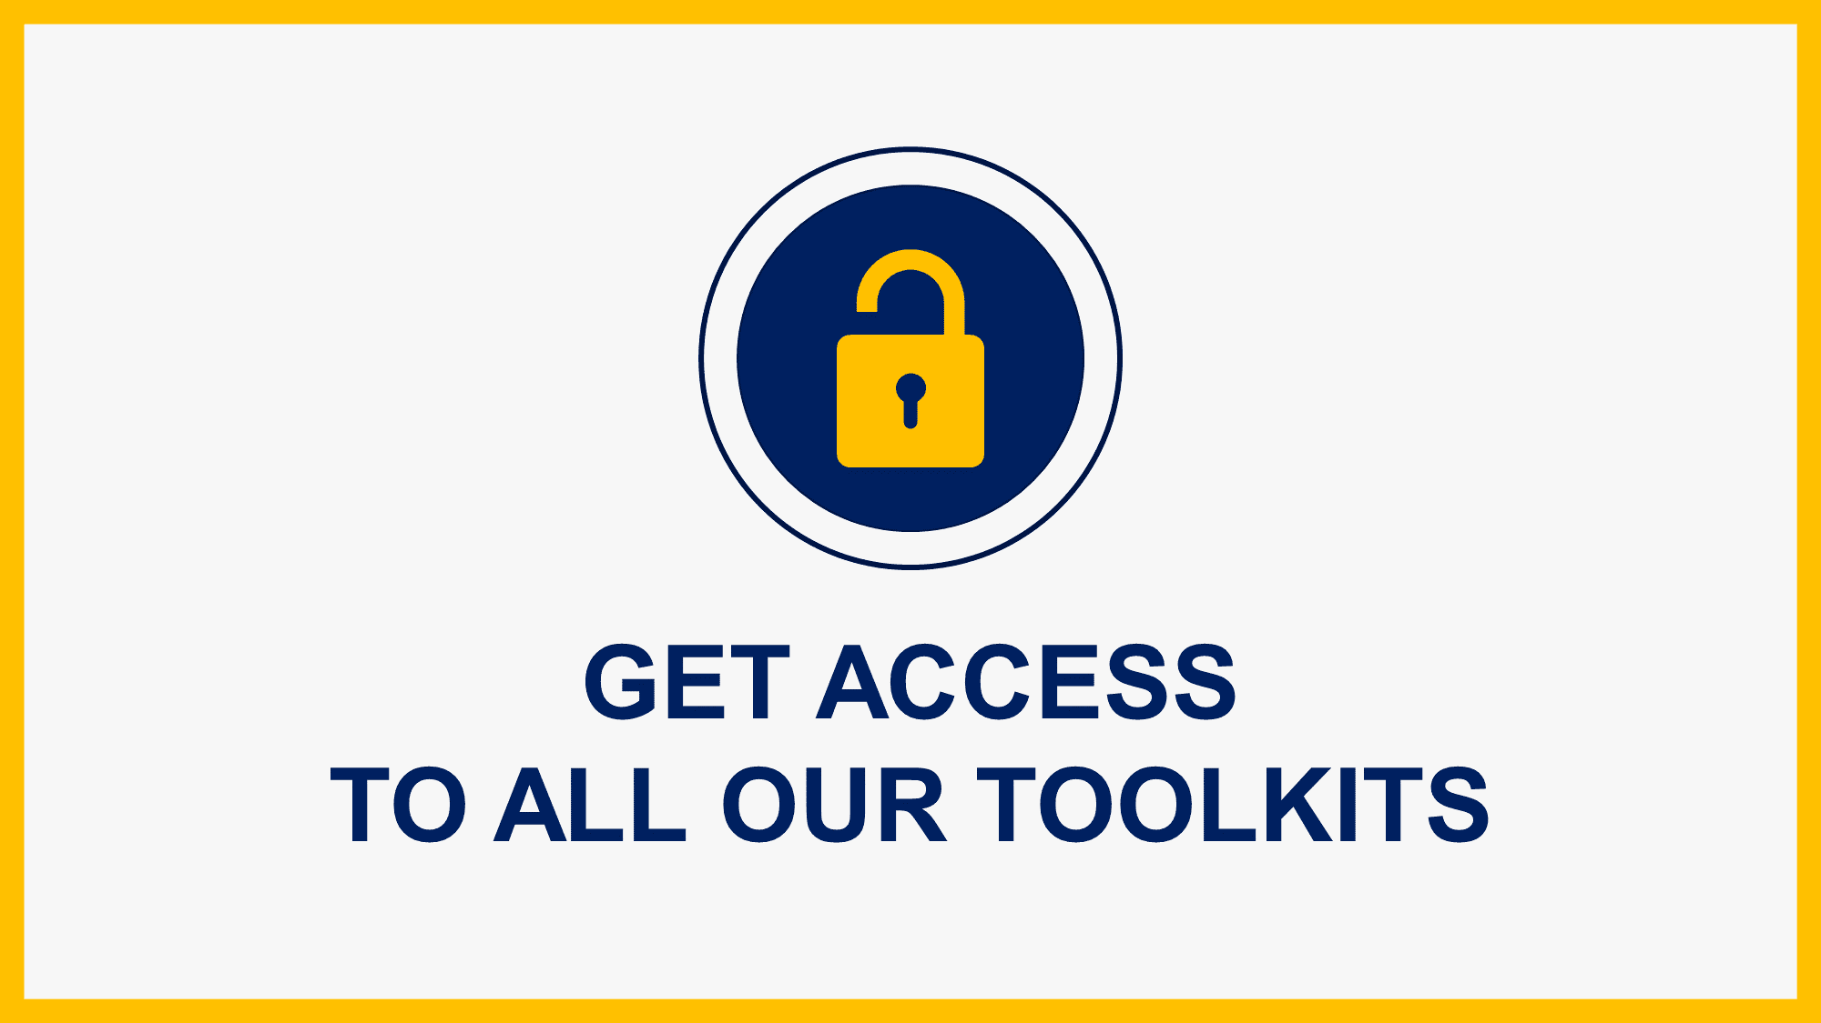
Interested in more than 1 Toolkit? Access all our Toolkits for half the price with our Gold Access
Gold Access
Click here to learn more

Slide 19
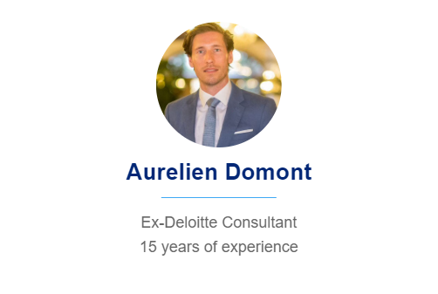
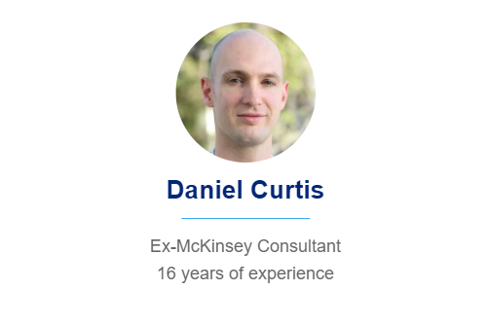
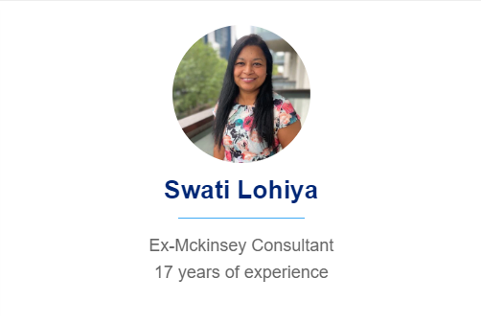
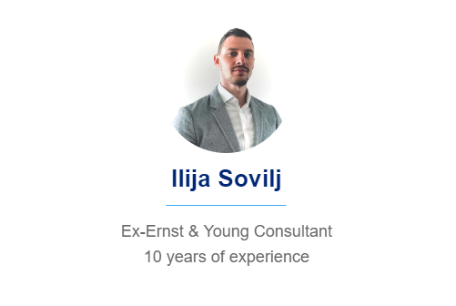
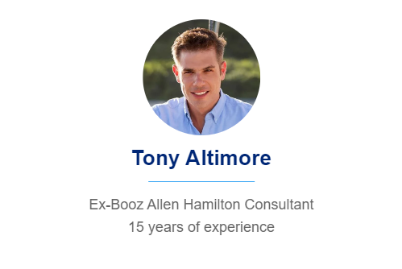
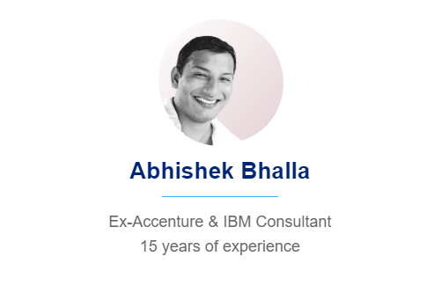
Need additional help? Send us a brief and we’ll find you the right talent from our network of 500+ tier-1 Management Consultants
Click here to send us a Project Brief

Slide 20

This was just a small preview.
www.domontconsulting.com

